Slide 1




Home Credit Default Risk
Group 23
Tanay Kulkarni
tankulk@iu.edu
Shefali Luley
sluley@iu.edu
Sanket Bailmare
sbailmar@iu.edu
Raj Chavan
rchavan@iu.edu

Slide 2
Project Description
Home credit utilizes several alternative data and methods to predict their client’s repayment abilities.
We will be using machine learning and statistical methods to determine these predictions.
Our goal in this phase is to study HCDR data and perform Exploratory Data Analysis.
We aim at cleaning and preprocessing techniques on the data as well as build the baseline pipeline after examining the accuracies of explored pipelines.

Slide 3
Exploratory Data Analysis
With the help of exploratory data analysis, we were able to summarize the main characteristics of the data set, by using statistical graphics and other data visualization methods.
We explored the following on the dataset:
The Data types and General Statistics of data.
Number of Missing values (percentage of the missing values.)
Numerical and Categorical Data.
Number of zeros in the columns in the data (Percentage of 0’s).
If the some numerical data column can be treated as categorical data?
Correlation of the numerical data with the “Target column”.

Slide 4
Visual Exploratory Data Analysis
Visual Exploratory data Analysis performed on Categorical values to understand their significance in data
1. How is the distribution of loan according to gender?
2. What is the marital status of client?
3. How many percent of client own a car?
4. How many percentage of flag owners are in the dataset? 5. What are the types of housing does the clients stay in?
6. What type of source of income does the clients have?
7. What of type of contract is loan the most?

Slide 5
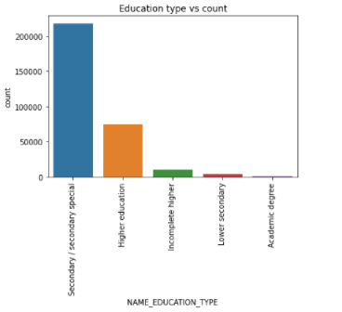
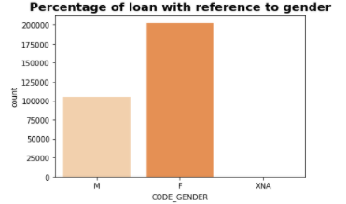
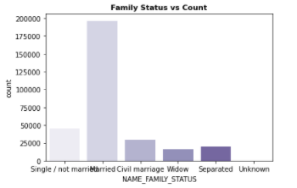
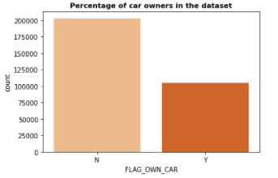
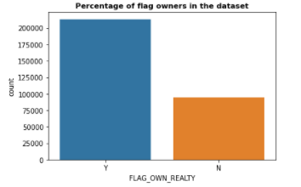
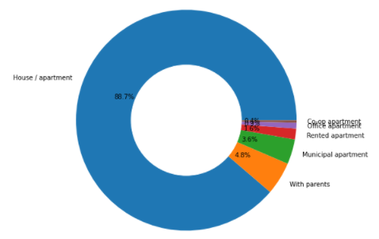
Some Examples

Slide 6
Baseline Pipeline
After Considering the thresholds for dropping non-significant columns, a set of final columns are collected.
We created the imputer pipelines to deal with the numerical and Categorical data separately.
We created the data pipeline which deals with the numerical and categorical data.
Once the data is fixed, we create a baseline pipeline which normalizes the data and feeds the data to Model.

Slide 7
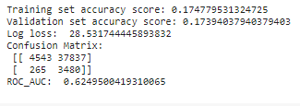
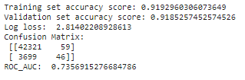
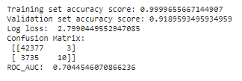
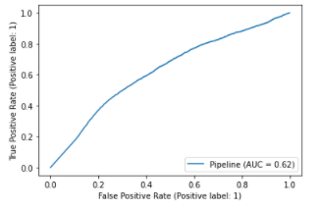
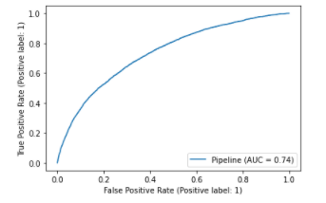
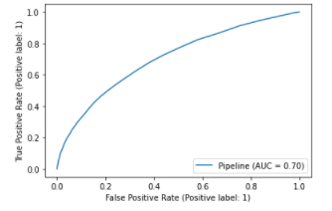
Types of Modeling Pipelines And Comparison
Naïve Bayes
Logistic Regression
Random Forest Classifier

Slide 8
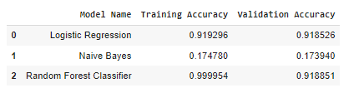
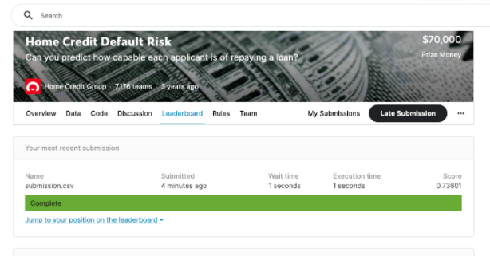

Accuracy in 3 Models

Slide 9
Conclusion and Next Steps
In this phase, we actually start playing with the dataset.
We cleaned the data and picked only the features which were important to the target variable and prediction.
We featured the data performing OHE and applied imputing methods to fix the data before feeding it to the model.
We were able to create the baseline pipeline and could experimentally understand the accuracies of the models like logistic regression, naive bayes and Random forest. Based on the results of the models we saw that there might be underfitting in naive bayes and overfitting in RandomForest.
The best model that we could get for Phase 0 was Logistic Regression which gave a training accuracy of 91.9% and the Kaggle submission accuracy of 73.6%
Further we are planning to improvise the feature engineering, perform hyperparameter tuning for our models alongside using K-Fold cross validation and GridSearchCV, we might also use some advanced gradient boosting models so that we could get as close to the best accuracy as we can.
After the aforementioned step we also plan to apply Deep Learning techniques like developing Artificial Neural Networks for better prediction results.

